Slide 1
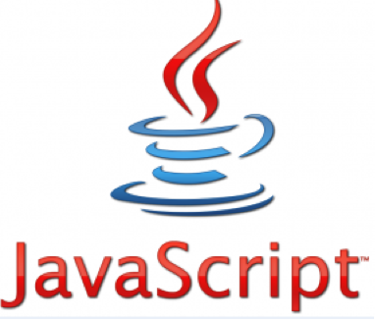
Introduction to

Slide 2
JavaScript: History
First web scripting language
Developed by Netscape and Sun
Initiated by Netscape and called LiveScript
In parallel with this, Sun was developing Java
Statements in JavaScript resemble statements in Java, because both languages borrowed heavily from the C language
JavaScript is reasonably platform-independent

Slide 3
What is JavaScript?
Primary purpose is for "client-end" processing of HTML documents
JavaScript code is embedded within the html of a document
An interpreter in the browser interprets the JavaScript code when appropriate
Code typically allows for "preprocessing" of forms and can add "dynamic content" to a Web page

Slide 4
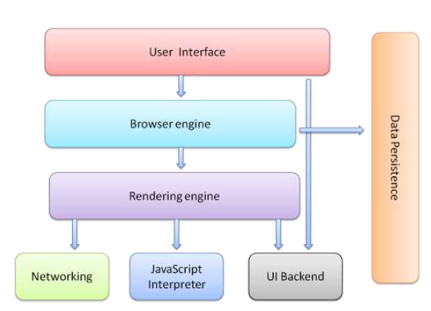
Web Browser Architecture

Slide 5
What can a JavaScript Do?
JavaScript gives HTML designers a programming tool.
JavaScript enhances Web pages with dynamic and interactive features.
JavaScript runs in client software
JavaScript can react to events.
Validate data.
It can be used to detect the visitor's browser
Create cookies.
Read/write/modify HTML elements

Slide 6
Client Side Script
When client makes the request, the HTML and all scripts will be downloaded into the browser and then the resultant HTML will be displayed in the browser is called client-side script.
Example: JavaScript, VB-Script etc.

Slide 7
Advantages of JavaScript
Less server interaction: User input can be validated before sending the page off to the server. This saves server traffic, which means less load on your server.
Immediate feedback to the visitors: They don't have to wait for a page reload to see if they have forgotten to enter something.
Increased interactivity: Interfaces can be created that react to the user activities e.g. mouse hover or uses the keyboard.
Richer interfaces: JavaScript can be used to include sliders to give a Rich Interface to the website visitors.

Slide 8
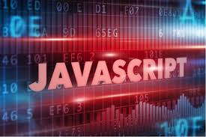
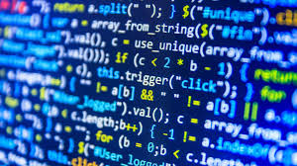
Including JavaScript in html page

Slide 9
When does JavaScript run?
JavaScript can run
as the page loads
as soon as the page is finished loading
in response to user input (Input data or click the button

Slide 10
How to include JavaScript in html?
JavaScript programs require the <SCRIPT> tag in .html files
These can appear in either the <HEAD> or <BODY> section of an html document
Functions and code that may execute multiple times is typically placed in the <HEAD>
These are only interpreted when the relevant function or event-handler are called
Code that needs to be executed only once, when the document is first loaded is placed in the <BODY>
<script >
ACTUAL JavaScript code here
</script>

Slide 11
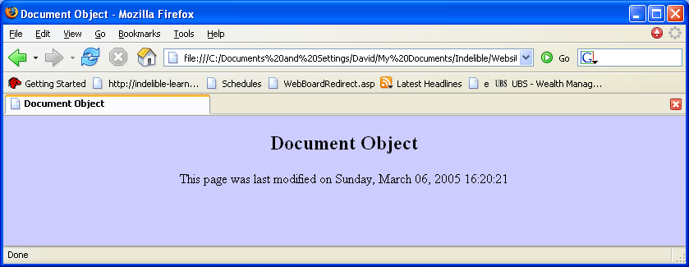
JavaScript that Runs as Page Loads
Normal HTML code
<HTML><HEAD><TITLE>Document Object</TITLE>
</HEAD>
<BODY bgColor=#ccccff>
<H2>Document Object </H2>
<SCRIPT language=JavaScript>
document.write("This page was last modified on”
+ document.lastModified);
</SCRIPT>
</BODY></HTML>
Enter JavaScript. Within the
html body (in this case)
document.write like print.
Get lastModified browser vrbl. . The + is catenation.
Calls function to get current date and output date
document.write("This page was last modified on” + document.lastModified);
Output this set of text (called a string)
Output the result of this ‘command’

Slide 12
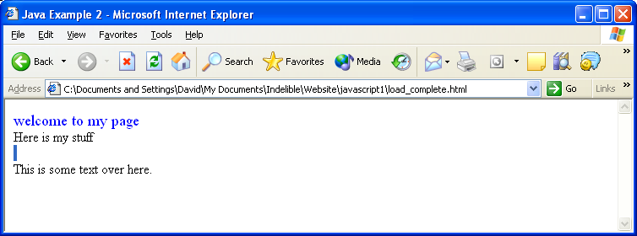
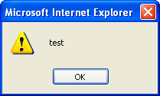
JavaScript that Runs when Loading Complete
<html> <head> <title> Java Example 2 </title> </head> <body onload=waitLittle()>
<font size=4 color=blue> welcome to my page </font>
<br>Here is my stuff
<br> <br>
<script language="JavaScript">
function waitLittle()
{
setTimeout( "alertMe()", 5000 );
}
function alertMe()
{
alert('test');
}
</script>
This is some text over here.
</body> </html>
Run ‘allertMe’ code call after 5000 miliseconds
Run ‘waitLittle’ when page is loaded
Create a pop-up box with test as text
After 5000 milisecond pop-up

Slide 13
Dealing with Browsers that don’t Support JavaScript
Some browsers may not support scripting or users may disable JavaScript.
<script language=“JavaScript”>
<!--
Javascript code
//--> </script>
This makes the script invisible to browsers that don’t support JavaScript by “commenting it out”. In addition, you can provide some page content that only displays when the browser DOESN’T handle JavaScript:
<noscript>
Your browser doesn’t support Javascript
</noscript>
The only limitation with this is that this will NOT be displayed by Netscape if the user has JavaScript just disabled.
“//” is a javascript comment which will stop JavaSript
From processing the “-->”characters

Slide 14
Using Separate JavaScript Files.
Linking can be advantageous if many pages use the same script.
Use the source element to link to the script file.
<script src="myjavascript.js”
language="JavaScript1.2”
type="text/javascript">
</script>

Slide 15
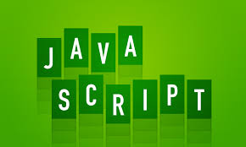
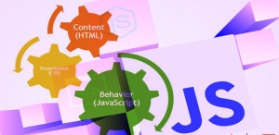
JavaScript Terminology

Slide 16
JavaScript Terminology
JavaScript programming uses specialized terminology.
Understanding JavaScript terms is fundamental to understanding the script.
Objects, Properties, Methods, Events, Functions, Values, Variables, Expressions, Operators

Slide 17
Objects
Objects refers to windows, documents, images, tables, forms, buttons or links, etc.
Objects should be named.
Objects have properties that act as modifiers.

Slide 18
Properties
Properties are object attributes.
Object properties are defined by using the object's name and the property name.
e.g., background color is expressed by: document.bgcolor .
document is the object.
bgcolor is the property.

Slide 19
Methods
Methods are actions applied to particular objects. Methods are what objects can do.
e.g., document.write(”Hello World")
document is the object.
write is the method.

Slide 20
Functions
Functions are named statements that performs tasks.
e.g. function sum ()
{statement here}
The curly braces contain the statements of the function.
JavaScript has built-in functions
Functions can be defined by the programmer

Slide 21

Naming Form Elements in HTML
<form name="addressform">
Name: <input name="yourname"><br />
Phone: <input name="phone"><br />
Email: <input name="email"><br />
</form>
Notes:
This example shows a simple form. Notice the name attribute is used at all points - to name the form, and to name each element within the form.

Slide 22
Forms and JavaScript
document.formname.elementname.value
Thus:
document.addressform.yourname.value
document.addressform.phone.value
document.addressform.email.value
Notes:
To refer to the value that a user has typed in a text box, you use the following naming system:
document.formname.elementname.value
This is a naming convention derived from the JavaScript object model:
document refers to the page displayed in the browser.
formname is supplied by the page author as the name attribute of the <form> tag - in the example it is addressform and refers to the whole form.
elementname is supplied by the page author using the name attribute of the <input> tag.
value is a predefined term which refers to the text typed in by the user.

Slide 23
Variables
A variable is a name associated with a piece of data
Variables allow you to store and manipulate data in your programs
Think of a variable as a mailbox which holds a specific piece of information

Slide 24
Variables
In JavaScript variables are created using the keyword var
Example:
var x = 10;
var y = 17;
var color = “red”;
var name = “Katie”;

Slide 25
Variables
<html><head>
<script>
var X;
function test() {
var x = 10;
var y = 17;
var color = “red”;
alert(“Color: ”+color);}
</script>
</head>
<body>
<h1> Introduction to JavaScript</h1>
<p id="demo">A Paragraph</p>
<button type="button" onClick=“test()"> Try it </button>
</body></html>

Slide 26
Variables
It is vitally important to distinguish between the name of the variable and the value of the variable
For example, in the expression var color=“red”, color is the name of the variable and red is the value. In other words, color is the name of the box while red is what is inside the box

Slide 27
Local and Global Variables
Variables declared within a JavaScript function, become LOCAL to the function.
Local variables have local scope: They can only be accessed within the function.
function myFunction() { var carName = “Cultus"; // code here can use carName }

Slide 28
Global Variables
With JavaScript, the global scope is the complete JavaScript environment.
In HTML, the global scope is the window object. All global variables belong to the window object.
var carName = “Cultus";
function myFunction() {
alert(“Car Model: ”+ carName); // code here can use carName }

Slide 29
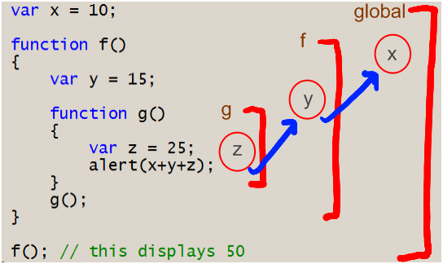
Global Variables

Slide 30
Data Types
Primitive Data Types
Numbers
Strings
Boolean (True, False)
Composite Data Types
Arrays
Objects

Slide 31
Primitive Data Types
Numbers - A number can be either an integer or a decimal
Strings - A string is a sequence of letters or numbers enclosed in single or double quotes
Boolean - True or False

Slide 32
Variables & Data Types
JavaScript is untyped; It does not have explicit data types
For instance, there is no way to specify that a particular variable represents an integer, string, or real number
The same variable can have different data types in different contexts

Slide 33
Implicit Data Types
Although JavaScript does not have explicit data types, it does have implicit data types
If you have an expression which combines two numbers, it will evaluate to a number
If you have an expression which combines a string and a number, it will evaluate to a string

Slide 34
Example: Variables
var x = 4;
var y = 11;
var z = “cat”;
var q = “17”;
var j=“10”;
Ans = x + y;
Ans => 15
Ans = z + x;
Ans => cat4
Ans = x + q;
Ans => 417

Slide 35
More Examples
var x = 4;
var y = 11;
var z = “cat”;
var q = “17”;
Ans = x + y + z;
Ans => 15cat
Ans = q + x + y;
Ans => 17411

Slide 36
Arrays
An array is a compound data type that stores numbered pieces of data
Each numbered data is called an element of the array and the number assigned to it is called an index.
The elements of an array may be of any type. A single array can even store elements of different type.

Slide 37
Creating an Array
There are several different ways to create an array in JavaScript
Using the Array() constructor:
- var a = new Array(1, 2, 3, 4, 5);
- var b = new Array(10);
Using array literals:
- var c = [1, 2, 3, 4, 5];

Slide 38
Accessing Array Elements
Array elements are accessed using the [ ] operator
Example:
var colors = [“red”, “green”, “blue”];
colors[0] => red
colors[1] => green

Slide 39
Adding Elements
To add a new element to an array, simply assign a value to it
Example:
var a = new Array(10);
a[0] = 17;

Slide 40
Array Length
All arrays created in JavaScript have a special length property that specifies how many elements the array contains
Example:
var colors = [“red”, “green”, “blue”];
colors.length => 3

Slide 41
Arrays: Example
<html><head>
<script>
function array_demo()
{
var scripts = new Array();
scripts[0] = "PHP";
scripts[1] = "ASP";
scripts[2] = "JavaScript";
scripts[3] = "HTML";
document.getElementById("display_lang").innerHTML =“Length of array: ”+scripts.length;
}
</script></head>
<body>
Create tag p with id display_lang
Create button to call the function array_demo()
</body>

Slide 42
Primitive Data Types versus Composite Data Types
Variables for primitive data types hold the actual value of the data
Variables for composite types hold only references to the values of the composite type

Slide 43
Variable Names
JavaScript is case sensitive
Variable names cannot contain spaces, punctuation, or start with a digit
Variable names cannot be reserved words

Slide 44
Programming Tips
It is bad practice to change the implicit type of a variable. If a variable is initialized as a number, it should always be used as an number.
Choose meaningful variable names

Slide 45
Statements
A statement is a section of JavaScript that can be evaluated by a Web browser
A script is simply a collection of statements
Examples:
Last_name = “Dunn”;
x = 10 ;
y = x*x ;

Slide 46
Programming Tips
It is a good idea to end each program statement with a semi-colon; Although this is not necessary, it will prevent coding errors
Recommended:
a = 3;
b = 4;
Acceptable:
a = 3; b = 4;
Wrong:
a =
3;

Slide 47
Operators
+ Addition
Subtraction
* Multiplication
/ Division
% Modulus
++ Increment
- - Decrement
= = Equality
! = Inequality
! Logical NOT
&& Logical AND
|| Logical OR
? Conditional Selection

Slide 48
Aggregate Assignments
Aggregate assignments provide a shortcut by combining the assignment operator with some other operation
The += operator performs addition and assignment
The expression x = x + 7 is equivalent to the expression x += 7

Slide 49
Increment and Decrement
Both the increment (++) and decrement (- -) operator come in two forms: prefix and postfix
These two forms yield different results
x = 10; x = 10;
y = ++ x; z = x ++;
y = 11
z = 10
x = 11 in both cases

Slide 50
Control Structures
There are three basic types of control structures in JavaScript: the if statement, the while loop, and the for loop
Each control structure manipulates a block of JavaScript expressions beginning with { and ending with }

Slide 51
The If Statement
The if statement allows JavaScript programmers to a make decision
Use an if statement whenever you come to a “fork” in the program
If ( x = = 10)
{ y = x*x;
}
else
{ x = 0;
}

Slide 52
Repeat Loops
A repeat loop is a group of statements that is repeated until a specified condition is met
Repeat loops are very powerful programming tools; They allow for more efficient program design and are ideally suited for working with arrays

Slide 53
The While Loop
The while loop is used to execute a block of code while a certain condition is true
count = 0;
while (count <= 10) {
document.write(count);
count++;
}

Slide 54
The For Loop
The for loop is used when there is a need to have a counter of some kind
The counter is initialized before the loop starts, tested after each iteration to see if it is below a target value, and finally updated at the end of the loop

Slide 55
Example: For Loop
// Print the numbers 1 through 10
for (i=1; i<= 10; i++)
document.write(i);
i=1 initializes the counter
i<=10 is the target
value
i++ updates the
counter at the end
of the loop

Slide 56
Example: For Loop
<SCRIPT LANGUAGE=
"JavaScript">
document.write("1");
document.write("2");
document.write("3");
document.write("4");
document.write("5");
</SCRIPT>
<SCRIPT LANGUAGE=
"JavaScript">
for (i=1; i<=5; i++)
document.write(i);

Slide 57
Functions
Functions are a collection of JavaScript statement that performs a specified task
For example, a function could be written to calculate area given width and height.
Functions are used whenever it is necessary to repeat an operation.
The function can then be called elsewhere in the script, or when an event fires.

Slide 58
Functions
Functions have inputs and outputs
The inputs are passed into the function and are known as arguments or parameters
Think of a function as a “black box” which performs an operation
Functions are either written in the < head > element or in an external file that is linked from inside the < head > element, which means that they can be reused in several places within the page.

Slide 59
Defining Functions
The most common way to define a function is with the function statement.
The function statement consists of the function keyword followed by the name of the function, a comma-separated list of parameter names in parentheses, and the statements which contain the body of the function enclosed in curly braces

Slide 60
Example: Defining Function
<head>
<script>
function square(x)
{alert(return x*x);
}
function f1()
{}…..
square(3);
</script>
</head>
Name of Function: square
Input/Argument: x
Output: x*x

Slide 61
How To Call a Function
The square(x) function does nothing sitting on its own in the head of a document; it has to be called.
Call the function from a simple form using the onclick event, so that when the user clicks the Submit button the area will be calculated and shown in an alert box.

Slide 62
Example: Calling a Function
<body>
<form name=“Square" action="" >
<input type="button" value=“Square"
onclick=“square(3)" / >
</body>
Name of Function: squrae
Input/Argument: 3
Output: 3*3

Slide 63
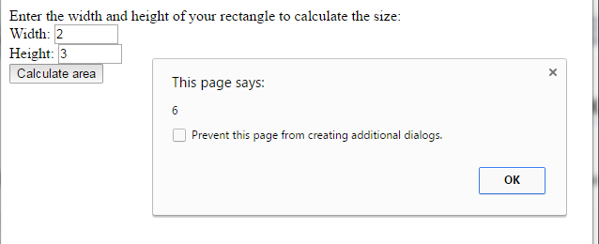
Example: Function
<html><head>
<script>
function calculateArea(width, height)
{area = width * height
return area}
</script></head>
<body>
<form name="formArea" action="" >
Enter the width and height of your rectangle to calculate the size: <br / >
Width: <input type="text" name="txtWidth" size="5" / > <br / >
Height: <input type="text" name="txtHeight" size="5" / > <br / >
<input type="button" value="Calculate area"
onclick="alert(calculateArea(document.formArea.txtWidth.value,
document.formArea.txtHeight.value))" / >
</form >
</body></html

Slide 64
Code Example
Style.css
.txt{ width:100px;
height:50px;
radius:5px; }
.blue{ background: blue;
color:yellow;
border-color:blue !important;}
.red { background: red;
color:white;
border-color:red !important;}
.center{padding: 50px;}
.test{width:150px;
height:150px;
border-radius: 5px;
border:1px solid;}
.scale{width:250px;}
colors.js
function toggleColor() {
var myButtonClasses = document.getElementById("submit").classList;
var myDivClasses = document.getElementById("demo").classList;
if (myButtonClasses.contains("blue")) {
myButtonClasses.remove("blue");
myButtonClasses.add("red");
//change color of box accordingly
myDivClasses.remove("blue");
myDivClasses.add("red");
myDivClasses.add("scale");
}
else if(myButtonClasses.contains("red")) {
//myButtonClasses.add("blue");
myButtonClasses.remove("red");
myButtonClasses.add("blue")
//change color of box accordingly
myDivClasses.remove("red");
myDivClasses.remove("scale");
myDivClasses.add("blue");
}}

Slide 65
Code Example
Togglecolor.html
<html>
<head>
<title>Untitled Document</title>
<script src=“js/colors.js"></script>
<link rel="stylesheet" type="text/css" href=“css/style.css">
</head>
<body bgcolor="#000000" >
<div id="demo" class="test center blue">
</div>
<div class="center">
<button id="submit" class="txt blue" onClick="toggleColor()">Try</button>
</div>
</body>
</html>

Slide 66
Media Queries in JavaScript
The matchMedia() method is used to run the queries,
This means you can run functions or load in more external scripts depending on device capabilities
window.matchMedia('screen and (min-width: 800px)');

Slide 67
Example
function widthWatch(mq) {
if (mq.matches) { foo(); }
else { // do something else }
}
var mq = window.matchMedia('screen and (min-width: 800px)');
mq.addListener(widthWatch);
widthWatch(mq);
Reference Book: the-modern-web-multi-device-web-development-with-html5-css3-and-javascript (Page 75-77)

Slide 68
EventTarget
The EventTarget interface is implemented by objects that can receive events and may have listeners for them. In other words, any target of events implements the three methods associated with this interface.

Slide 69
Event Listener
The addEventListener() method of the EventTarget interface sets up a function that will be called whenever the specified event is delivered to the target.
Reference: https://developer.mozilla.org/en-US/docs/Web/API/EventTarget/addEventListener

